Slide 1
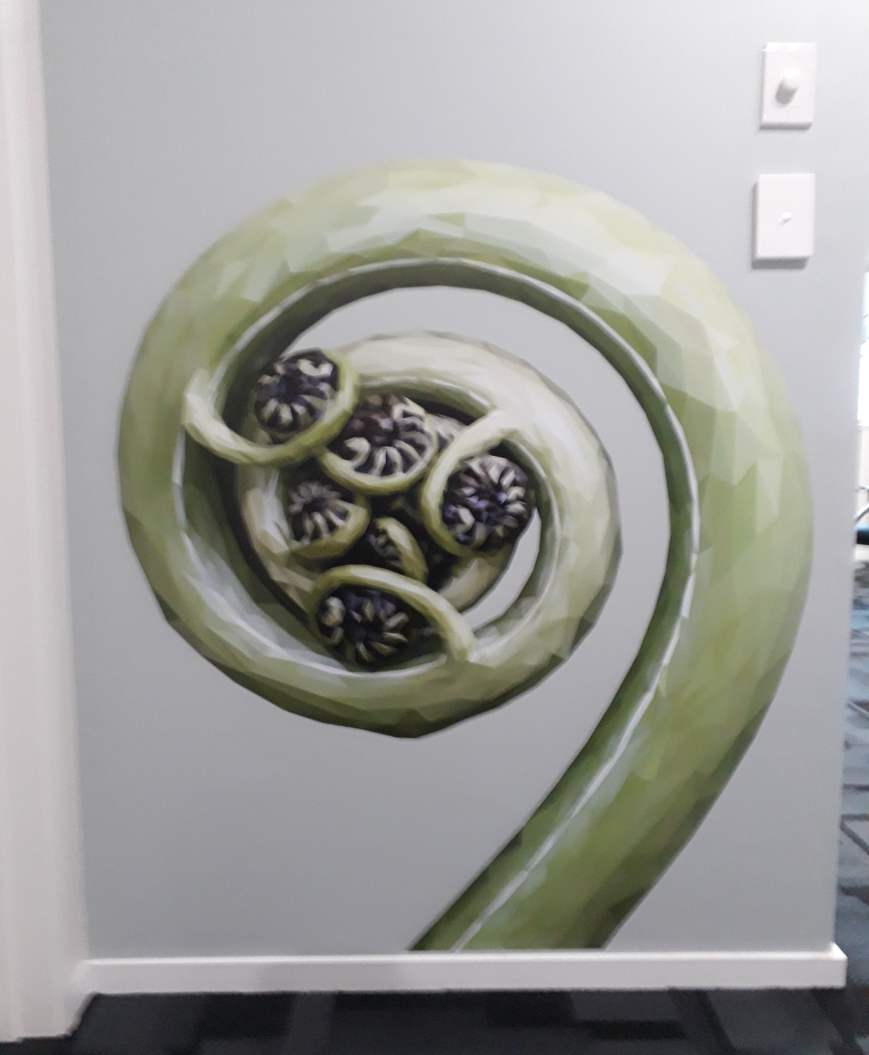
Waihi Family Doctors
Improving blood sugar levels for type 2 Diabetics

Slide 2
Practice profile
About us and our Philosophy - Our focus is to provide high quality family orientated patient centred healthcare ensuring Oritetangata (equity), and accessibility to all our patients to support their Taha Tinana (wellbeing)
PROFILE/SUMMARY OF THE PRACTICE:
Waihi Family Doctors practice family medicine: we believe in encouraging and supporting our patients to be proactive in disease prevention as well as disease management.
The practice was established in 2014 by Dr. Tineke Iversen and her husband Mr. Robin Douglas, with the support of Practice Manager Raewyn Norman and nurse Manager Di Pirrit. This core team of four have led the practice to grow exponentially in the first years: however, since July 2021 we have closed books due to lack of a full team of permanent GP’s.
We hope to have secured permanent staff and to re-open our books by July 2023, and are currently in discussion with overseas Doctors to achieve this.
WFD played a significant role in the vaccination programme during the pandemic, organising and staffing mass drive through vaccination events every Saturday for several months. Staff and management worked extra hours and days continuously to vaccinate our community, and achieve great results.
We operate from a purpose-built building, and are equipped with modern technology and tools.
We are fortunate to have a very stable staff of experienced practice nurses and administration staff, they collectively are the key to our success.
We have family groups amongst the staff, including to husband and wife pairs, and two parent and child groupings, we are truly a family practice.

Slide 3
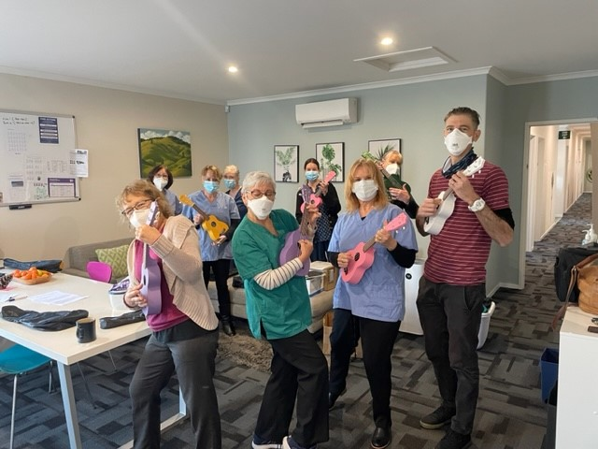
Our People
Our Team
Practice Owner (Lead GP) Tineke Iversen
Rae Norman – Practice Manager
Dianne Pirrit – Nurse Manager
Robin Douglas – Operations Manager
GPs - Andy Gibson , Nick Ribet
Practice Nurses - Vanessa Kinton , Tui Madsen, Stephanie Laurie, Kay Arbuckle , Raewyn Kinloch
Primary Care Practice Assistant – Sarai Solomona , Lucy Gibson (3rd Year Medical Student)
Administration Team Leader - Sheryl Pooley
Receptionists - Annette Gibson, Mary-Anne Parry, Sue Jones ,Corinne Meiklejohn, Simoe Godsmark
Core Quality Improvement Team members - Tineke Iversen, Rae Norman, Dianne Pirrit, Vanessa Kinton, Sarai Solomona

Slide 4
Problem / Issue / outcome
Specific – Type 2 Diabetes aged 15-74 years from diverse culture backgrounds with elevated HbA1C’s of more than or equal to 64.
Measurable – Qualitative data collected from our PHO monthly targets
                Quantative data collected from our patient survey.
Achievable – would like to improve blood sugar levels to within target range HbA1C 50-55 to achieve better health outcomes for Type 2 Diabetics.
Relevant – High number of Diabetics No. 155 classified diabetics -within our enrolled population at risk of further health problem due to elevated HbA1c. Of these 155 patients 64 have HbA1c of 64 and over (report date 21/01/2023).
Timely – Our project will run over a 6 month period with clinical data collected (from NHC PHO) at baseline and 6 months and will be cost effective. We will continue monitoring 6 monthly.
PHO National Hauora Coalition Pinnacle Midlands Health Network – Guide for general practice clinical management in type 2 diabetes Updated 2021.

Slide 5

Diabetes Patient Survey

Slide 6
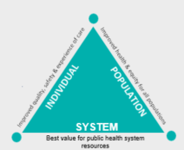
Triple Aim Alignment
Improved quality, safety and experience of care. New Zealand Health and Safety Goals – Live Well, Stay Well, Get Well. Audit to identify numbers of Type 2 Diabetics within the practice thereafter an audit to determine which patients HbA1c are overdue and out of range. The whole practice team will work together to achieve this. A written patient survey “How are we doing?” what can we do better to engage the patient with raised HbA1c. Engaging with whanau, family and other stakeholders i.e. Tiakina te Tangata. Further audit to see if outcomes have improved with follow up discussion at the Practice Meeting and further patient survey at 6 months.
Improved health and equity for all populations. Recognising barriers to accessing healthcare in general practice to include age, gender, disability, ethnicity to ensure that all patients receive consistently positive, high-quality healthcare interactions.
Best value for public health system resources. Annual Diabetic review funded by DHB, our aim is to focus on patients who have not engaged and get them into this valuable programme to provide therapeutic quality healthcare to benefit health outcomes for all.
Type of evidence/data used and sources. Internally generated from PMS – Query Builder – using recall Med Tech recall system and PHO health target reports and patient survey feedback.
Quality Improvement methodology. PDSA – Plan Do Study Act – this will enable the practice team to achieve scalable quality improvement initiatives and outcomes. We will do this by regular monthly reporting of data from PHO with completed Diabetic annual reviews. Ongoing monitoring of HbA1c blood test levels for those with elevated results – this goes into Nurse recalls, also highlighted as an alert on the patients notes enabling all of the team to address and to action.

Slide 7
Practice Demographics

Slide 10
Equity Implications
MOH defines equity as “peoples needs rather than social privileges which guide distribution of opportunities for wellbeing. Recognizes different people with different levels of advantage may require different approaches and resources to get equitable outcomes. This includes the cultural relevance for our Maori population to help provide access to self management support underpinned by Kaupapa Maori approaches. Data taken from Waihi Family Doctors 2 year referral period Tiakina Te Tangata report 2019-2021.
We have shown pie charts to demonstrate current percentages of our enrolled population, with monthly updates. We will review data and outcomes with pie chart demonstration in 6 months time to show overall progress/improvement.
References - Tiakina Te Tangata Long Term conditions report 2019-2021
Whakamaua Maori Health Action Plan 2020 – 2025.

Slide 11
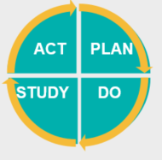
Project plan & mile stones
Key mile stones
Target population.
Patient Survey
Analyse results
Changes and improvements
Further patient survey at 6 months
Plan-Do-Study-Act (PDSA) Cycle
The PDSA is an improvement model used to carry out change. The four stages include:
Plan: Develop project team and formulate plan. Do: Carry out planned actions and monitor progress.
Study: Analyse and reflect on project outcomes. Act: Decide on further actions to sustain improvement.

Slide 12

Project Interventions
Outlined are our action points that will help us achieve the goals set out.
Survey – Waihi Family Doctors Diabetes Management Survey – being posted out to our identified Diabetics within the practice/community. Collected surveys distributed equally amongst the team RN Di Pirrit, RN V Kinton, HCA S. Solomona.
Managed follow up organised depending on results. Emphasis on identifying our Maori patients at risk. Those identified with elevated or no up to date HbA1c, arrange lab form, Nurse with prior engagement/bond with patient to phone and advise/explain. Those unable to collect form will post to them to facilitate this. Extra support with Tiakina Te Tangata involvement offered to our patients with consent. Also Diabetes Nurse specialist for phone calls, emails visits to review patients.
Non responder patients – if after survey sent, follow up phone call and text – alert on system to offer opportunistic service/screening when patient presents to the practice.
Pro

Slide 13
Quantitative Measurements / Data
Practice Meeting July 2023 – discussed findings outcomes implications for the practice.
Minutes of the Meeting – feedback from study presented to colleagues July 2023 – big thank you to all involved with the extra help with the surveys.
Pleased to announce a small reduction in HbA1c in our community and percentage increase in DAR’s completed. March was 68.16% to June 83.87 % ( see attached monthly performance result). Numbers etc.

Slide 14
Staff Meeting Minutes
Practice Meeting
Tuesday 11 July 2023
1pm
Present: Simoe, Raewyn, Sheryl, Sarai, Vanessa, Steph, Mary-Anne, Rueben, Di, Corinne, Tineke, Nick, Rae
DP: Quality Report. Health targets, we have improved in everything. Kiri (from the PHO) has been beneficial to us as a smear taker.
Continuous Quality Information (CQI): out of 155 patients who need to do a blood test (HBA1C) it has dropped from 14 patients to 6. DARs are up, now at 83%. Sarai is sending out forms and contacting patients re this. Thanks to Sarai.
We need a plan in place for everyone to get involved to target the non-compliant/non responders.

Slide 15
Issues / findings
There were 155 surveys sent out in April 2023 to our Type II Diabetics, of these however only 24 returned surveys and 131 were non responders despite repeated efforts to contact. Results were collated 30th May 2023, further txt messages sent reminding patients to return survey, nil response.
Common themes identified – mostly a positive outcome, however due to small numbers returned it was hard to evaluate the true representation of our community. Of these common issues identified were some health literacy issues with language. For example the need for bi-lingual terms both Maori and English, an example of this was a patient not knowing what “Tiakina Te Tangata” wording meant.
Comments in the survey also identified – lack of understanding about Diabetes medications and how it worked.
From the survey it enabled us to identify gaps in patient knowledge – One of the ways we are addressing this is to liaise with Diabetes Nurse Specialist with the PHO to try and find ways to improve services for our patients.

Slide 16
Actions to sustain improvements & adjustments to process
Of the 24 surveys returned, 13 surveys had patient comments which were addressed – improvements as follows:
We have identified health literacy to be a barrier for patients with their understanding of Diabetes – Nurse tasks are followed up with phone calls to patient to address their queries, or face to face if they prefer.
We have identified response rates in the community were low- we have addressed this by continued efforts from the team here at Waihi Family Doctors. Phone calls, face to face, letters, recalls, also creating a new role for our HCA with administration of recalling the Diabetic Annual Reviews, including sending Lab forms to Pathlab, and chasing/following up non-responders.
With further correspondence i.e. surveys out to our patients, we will endeavour to give full consideration to patient’s preferred language and understanding thereof this will include being mindful of translation of words/terms as identified in our survey.
Nursing CPD courses on Diabetes run by the PHO – upskilling our Nursing team with up to date knowledge and information regarding patients with Diabetes.

Slide 17
Reflecting back
Our journey findings so far:-
Highlights
Lowlights
Lack of Response in our distributed surveys.
Cultural competency training at the practice has been identified as overdue for many staff members.
we currently have a copy of hauraki maori health action pho plan 2017– we have since changed pho to the national hauora coalition and we have requested a copy of this to drive improved health outcomes for maori/pacifica within our practice.
IMPROVEMENT IN RECORDED HBA1C’S FOR MAORI AND PACIFICA AND FOLLOW UP DIABETES CARE THEREOF. EXAMPLE AS FOLLOWS:-
Jan 2023 – PHO monthly report on Diabetes stats
DIABETES IMPROVEMENT PROJECT IDENTIFIED THAT 14 PATIENTS HAD NO HBA1C RECORDED IN THE LAST 12 MONTHS.
AN ALERT WAS CREATED FOR THESE PATIENTS ON OUR MEDTECH COMPUTER SYSTEM.
Follow up report – post survey - June 2023 – PHO monthly report
SHOWS SIGNIFICANT IMPROVEMENT IN DAR ‘s completed .OUR LATEST RECORDS NOW SHOW ONLY 6 PATIENTS HAVE NO HBA1C RECORDED, AND OF THESE PATIENTS NONE WERE IDENTIFIED AS BEING MAORI OR PACIFICA.

Slide 18
Bibliography
Numbers and Statistics
Readings and Studies
Data PMS internally generated
Query Builder
MedTech Recall System
PHO Health Targets 2021
Patient Survey Feedback
Recommendations to enhance General Practice to improve access of Tamariki to immunisation May 2013 Corbet T
Experiences of Maori of Aotearoa New Zealand’s public health system: a systematic review of two decades of published qualitative research 2019 Graham R Masters-Awatere Bridgette
Hauraki PHO Maori Health Action Plan 2017
Improving Access to Health Care Among New Zealand’s Maori Population 2006 Ellison-Loschmann L Pearce N
Ministry of Health Maori health models – Te Whare Tapa Wha – One model to understand Maori Health – the four cornerstones -2021.
Quality Programmes Practice Profile Waihi Family Doctors

